Slide 1
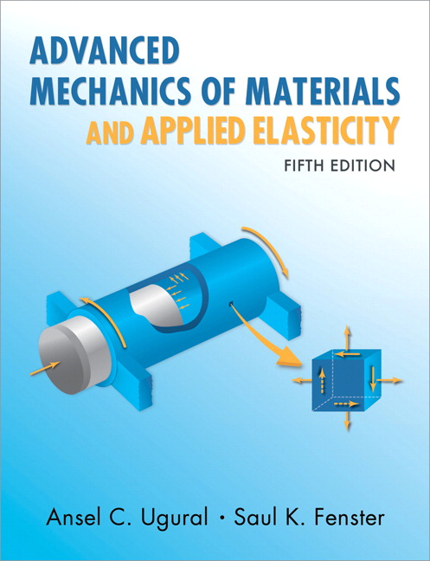
Advanced Mechanics
(Lecture 19)
ANNOUNCE / BUSINESS
HW 08 (due Today, 3/20)
HW 09 (due Tuesday, 3/25)
HW 10 (due Thursday, 3/27)
Exam 03: Thursday, 04/03
PREVIOUS
Shear center; Shear flow
TODAY
Torsion

Slide 2
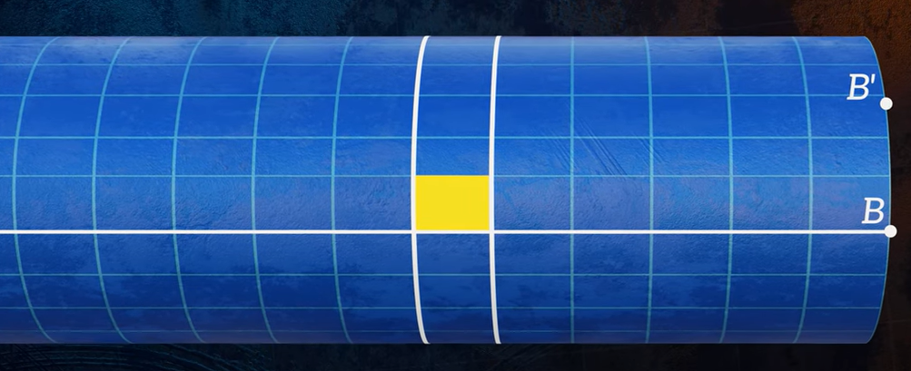
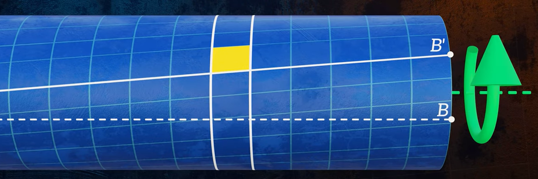
(The Efficient Engineer – YouTube)

Slide 3
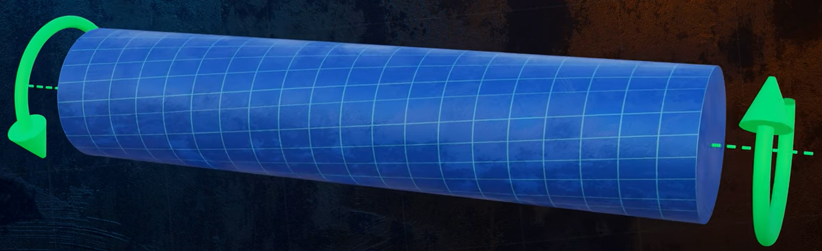
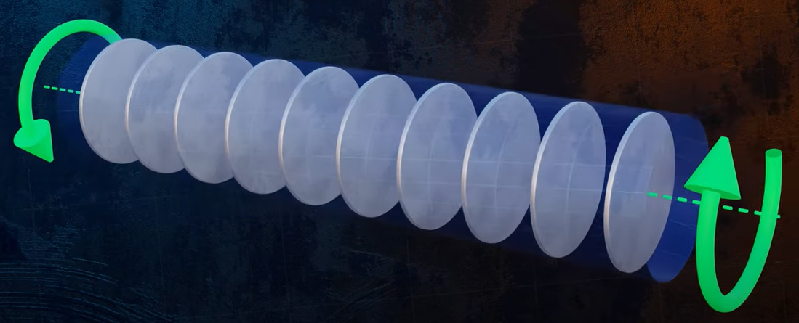
(The Efficient Engineer – YouTube)
Plane sections do not remain plane for non-circular cross-sections!

Slide 4
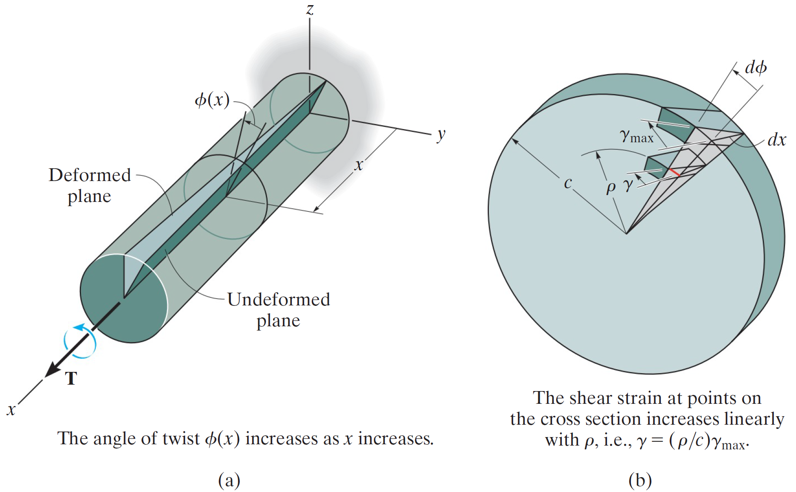
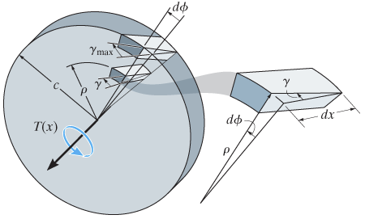
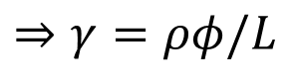
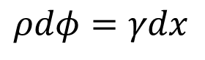
Shear Strain
$$ρdφ=γdx$$
$$⇒γ=ρφ/L$$
* Note that there is no shear strain in the $y$-$z$ plane.

Slide 5
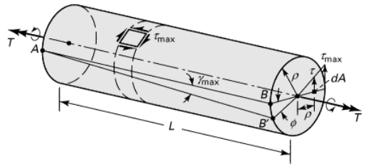
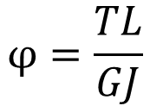
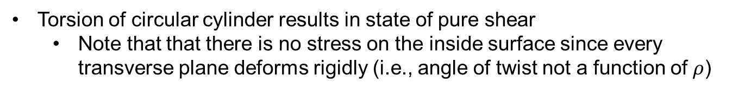
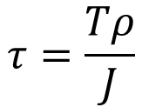
Angle of Twist; Shear Stress
Angle of Twist
$$φ=\frac{TL}{GJ}$$
Shear Stress
$$τ=\frac{Tρ}{J}$$
Torsion of circular cylinder results in state of pure shear
Note that that there is no stress on the inside surface since every transverse plane deforms rigidly (i.e., angle of twist not a function of $ρ$)

Slide 6
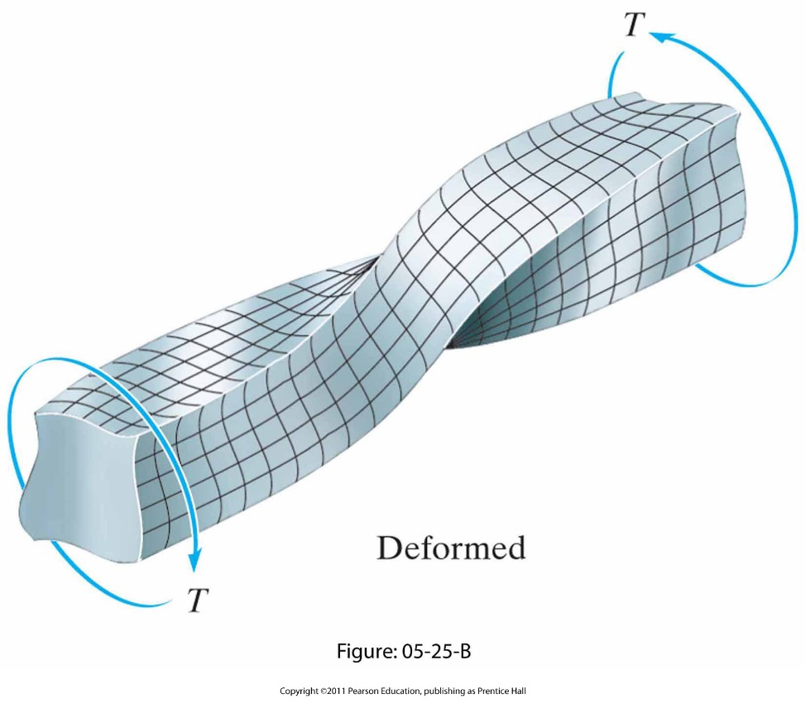
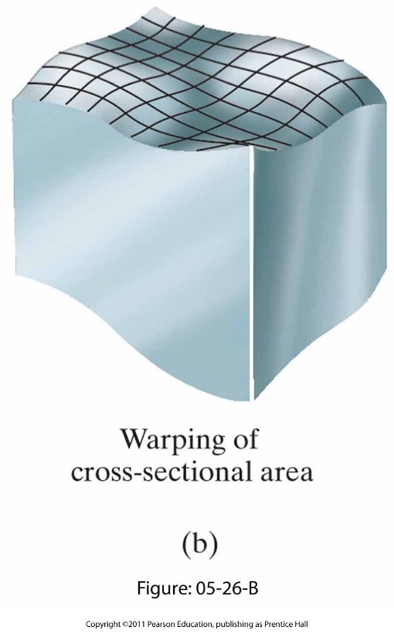
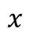
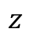
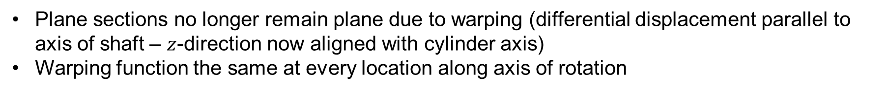
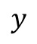
General Torsion
$$y$$
$$z$$
$$x$$
Plane sections no longer remain plane due to warping (differential displacement parallel to axis of shaft – $z$-direction now aligned with cylinder axis)
Warping function the same at every location along axis of rotation

Slide 7
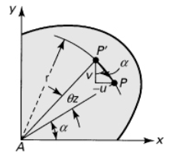
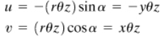
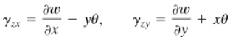
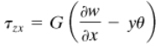
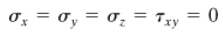
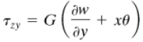
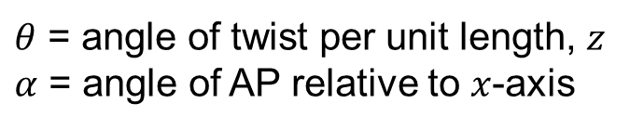
General Torsion
Displacement
$θ$ = angle of twist per unit length, $z$
$α$ = angle of AP relative to $x$-axis
Strain
Stress

Slide 8
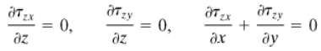
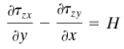
General Torsion
Equations of Equilibrium reduce to
Equations of Compatibility become
where
Can thus solve for stresses, but need to solve displacements first

Slide 9
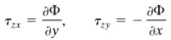
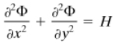
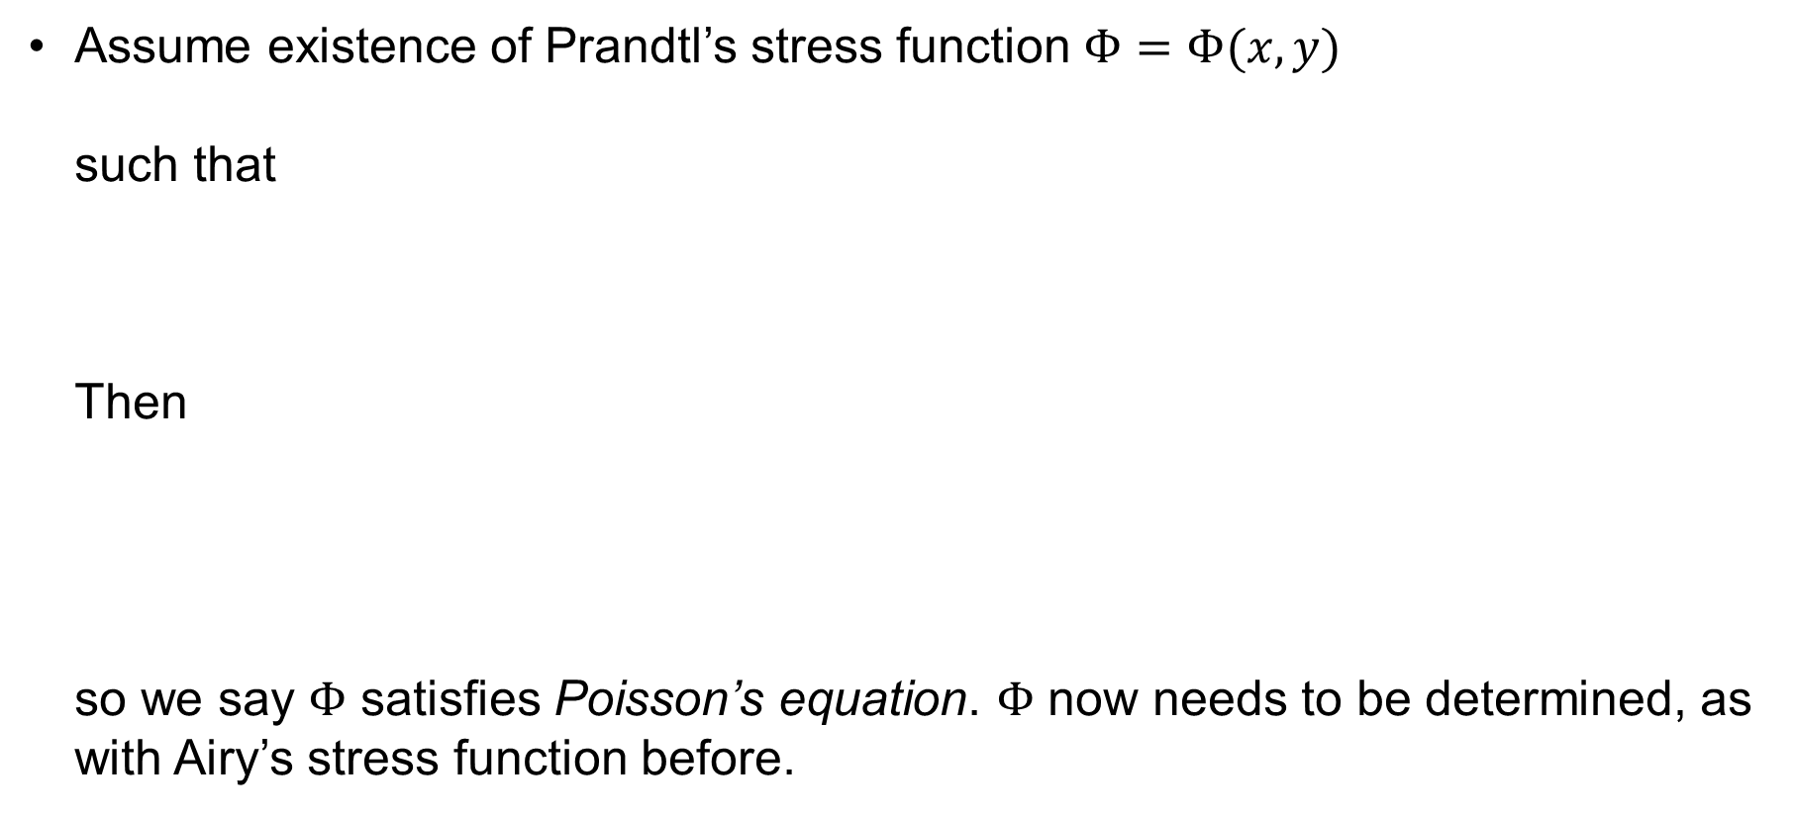
Prandtl’s Stress Function
Assume existence of Prandtl’s stress function $Φ=Φ(x,y)$
such that
Then
so we say $Φ$ satisfies Poisson’s equation. $Φ$ now needs to be determined, as with Airy’s stress function before.

Slide 10
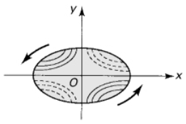
Warping
Warping occurs along cylinder axis. Looking from the end, each section appears to be undeformed (but rigidly rotated)
Solid lines indicate portions of section that become convex (out of image)
Dashed lines indicate portions that become concave (into image)
Notes:
Tempting to attribute this to some sort of Poisson effect but remember that the normal strain along the z-axis is zero, so it can’t be a Poisson effect. This behavior would clearly not be this simple at the fixed end if warping is not allowed there.

Slide 11
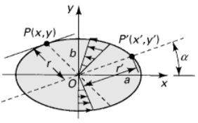
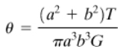
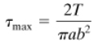
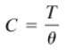
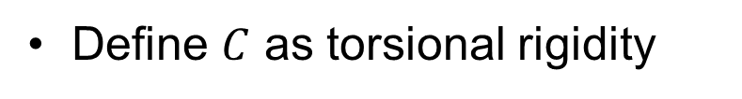
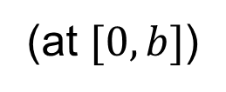
Solutions – Ellipse
(angle of twist per unit length)
(at $[0,b]$)
Define $C$ as torsional rigidity

Slide 12
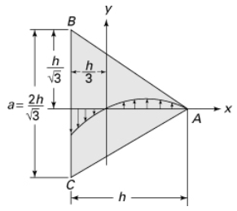
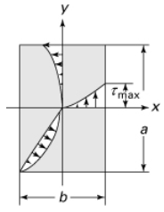
Solutions
max
zero!

Slide 13
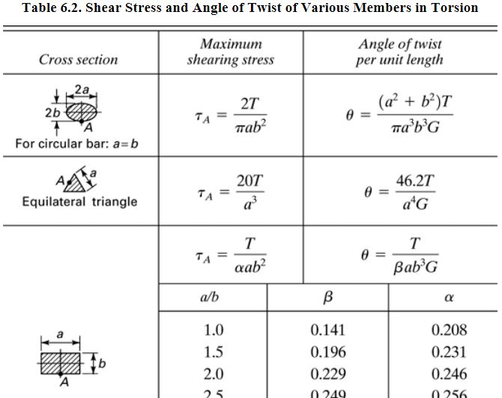
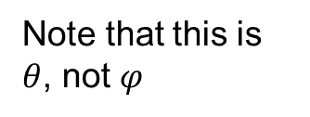
Solutions
Note that this is $θ$, not $φ$

Slide 14
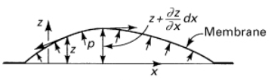
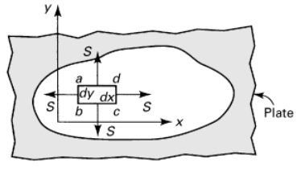
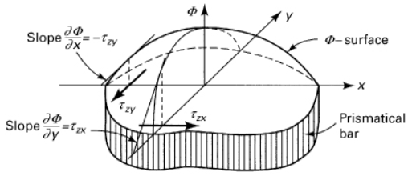
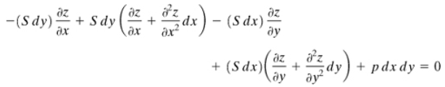
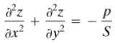
Membrane Analogy
Consider section of pressurized membrane covering opening of arbitrary shape:
Equilibrium requires …
Poisson’s Eq. again

Slide 15
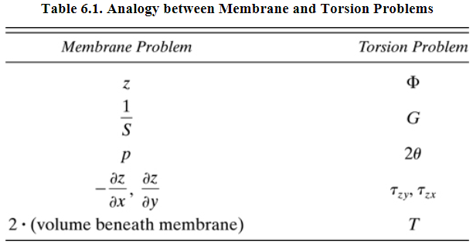
Membrane Analogy

Slide 16
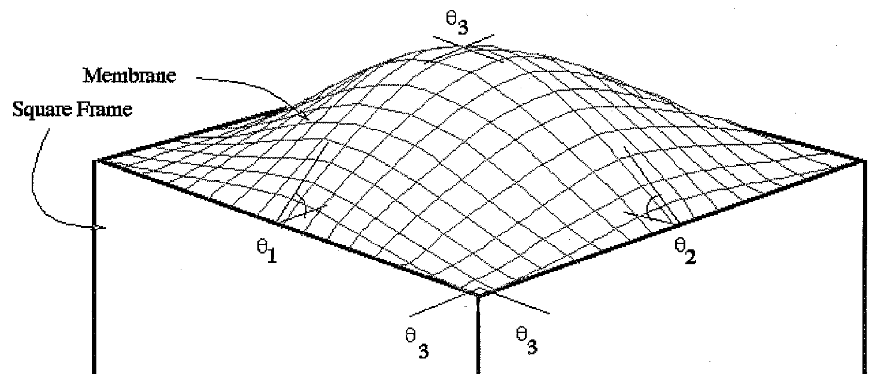
Membrane Analogy
Magnitude of shear stress is proportional to the slope of the surface
Direction of shear stress is on horizontal plane, tangent to surface
Applied torque is proportional to volume under membrane

Slide 17
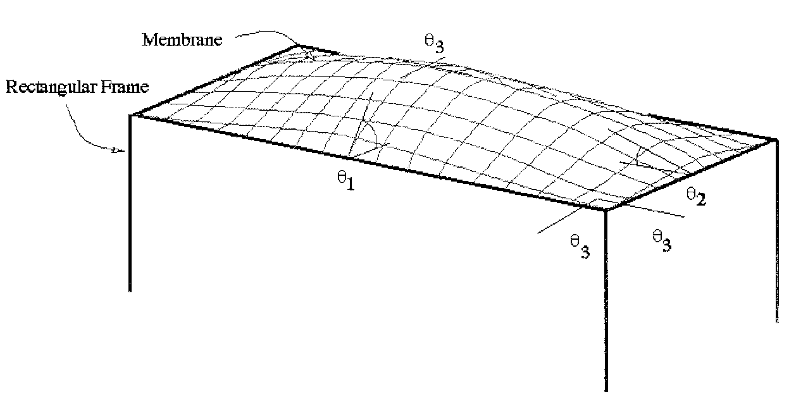
Membrane Analogy

Slide 18







Thin-Walled Rectangular Section
Assume cylindrical membrane shape over full length of $b$
Then, making substitutions using membrane analogy,
($J_{e}$ is effective polar moment of inertia)

Slide 19




Thin-Walled Open Sections
Can apply findings from rectangle to any thin-walled open section
b is length of centerline along section
For variations in thickness, as in (c),
and
(Note that this approach neglects stress concentrations.)

Slide 20

Membrane Analogy
What if shaft has a hole, or hollow section, in it?

Slide 21



Thin-Walled Closed Sections
For membrane formed over thin-walled section, curvature can be neglected.
Then $τ=h/t$ (note $h=τt=q$; shear flow [height] is constant around shape, so $τ$ changes if $t$ changes)
And $T=2Ah$ (twice the volume under the membrane), where $A$ is the area inside the perimeter of the centerline.
Combining: $τ=T/2At$
(particularly helpful for thin-walled shapes not included in Table 6.2 and for those with varying thickness)

Slide 22


Thin-Walled Closed Sections
Membrane analogy also allows us to calculate angle of twist (per unit length) for closed, thin-walled sections …
This calculation is easier than it looks, since the shear stress will be constant along $s$ as long as thickness is constant … see Example 6.7 in text

Slide 23






Thin-Walled Closed Sections – Example
Compare max shear stress in circular tube, using thin-walled equation ($τ=T/2At$; note same as in Table 6.2 below), with that from standard torsion formula. Denote radius as $r$ and thickness as $t$.
$$τ_{2}=\frac{Tr}{J}$$
vs
$${=τ}_{1}$$
For $β=r/t$,
$$β$$ | $${τ_{1}}/{τ_{2}}$$
5 | 0.92
10 | 0.95
20 | 0.98

Slide 24






Thin-Walled Closed Sections
Can apply to tubes with multiple sections
In section shown,
$$τ_{1}=\frac{h_{1}}{t_{1}}$$
$$τ_{2}=\frac{h_{2}}{t_{2}}$$
$$τ_{3}=\frac{h_{1}−h_{2}}{t_{3}}$$
And
$$τ_{1}t_{1}=τ_{2}t_{2}+τ_{3}t_{3}=q$$
As before, we observe that $q$ is constant, distributing itself as water would flow through a channel

Slide 25

Fluid Flow Analogy
Shear stress also analogous to velocity of ideal (inviscid, incompressible) fluid within rotating cavity having same shape as solid portion of bar
Stress concentration is equal to fluid velocity at the inclusion divided by fluid velocity of outside shape without inclusion.

